Slide 1
Employee Attrition Analysis
By Gelle Priyanka

Slide 2
Introduction
"The HR Analytics Dashboard is a Power BI-based project that provides insightful visualizations and analysis of human resources data. It offers HR professionals a comprehensive overview of key metrics and trends, enabling data-driven decision-making to optimize HR processes and improve employee engagement.
With this dashboard, HR professionals gain crucial insights into key areas such as Employee Count, Attrition Trends, Demographics, Job satisfaction levels, and more.
HR teams can use its capabilities to make smart decisions and effectively manage the workforce."

Slide 3
Problem Statement
XYZ company, established a few years ago, is facing a 16.12% attrition rate over the past couple of years. This high attrition rate is significantly affecting the company in many aspects. XYZ company has approached an HR analytics consultancy to analyze their data to understand why employees are leaving and reduce the attrition rate. As an HR analyst, you are building a dashboard to help the organization make data-driven decisions.

Slide 4
Steps Overview
Data subset collected from Unified Mentor Pvt Ltd.
Understanding the Data.
Data Cleaning & Finding Missing values.
Data Visualization
Data Manipulation
Researchers and Analysis:
Understanding the data through exploration and analysis.
Software and Tools:
Thanks to the developers of the software and tools used for data analysis and visualization.
Technologies Used:
📈 Power BI
🔢 Excel

Slide 5
Main KPIs
Summary Statistics
The analysis focuses on several key performance indicators (KPIs) to understand attrition patterns:
Attrition Rate: The percentage of employees leaving the company.
Average Tenure: The average number of years employees stay with the company.
Department-wise Attrition Rate: Attrition rate segmented by departments.
Age-wise Attrition Rate: Attrition rate segmented by age groups.
Salary Attrition Rate: Attrition rate segmented by salary .
Job Satisfaction: Measured through employee surveys or performance reviews
Total Employees: 4410
Attrition: 711
Attrition Rate: 16.12%
Active Employees: 3699
Average Age: 37 years
Average Years in Company: 7

Slide 6
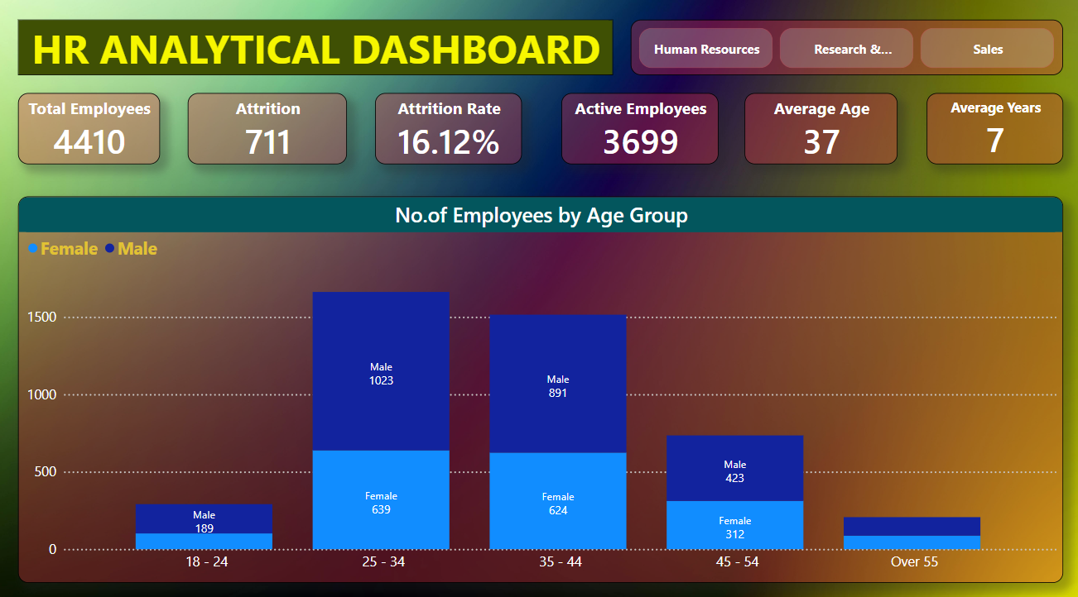
Mock – up Dashboard

Slide 7
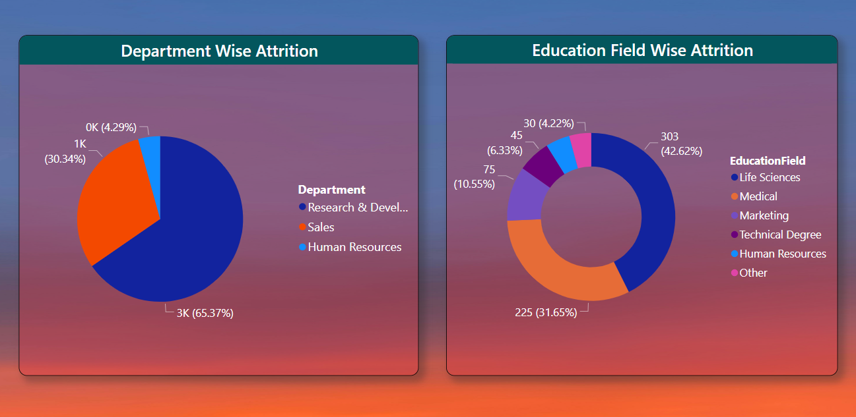

Slide 8
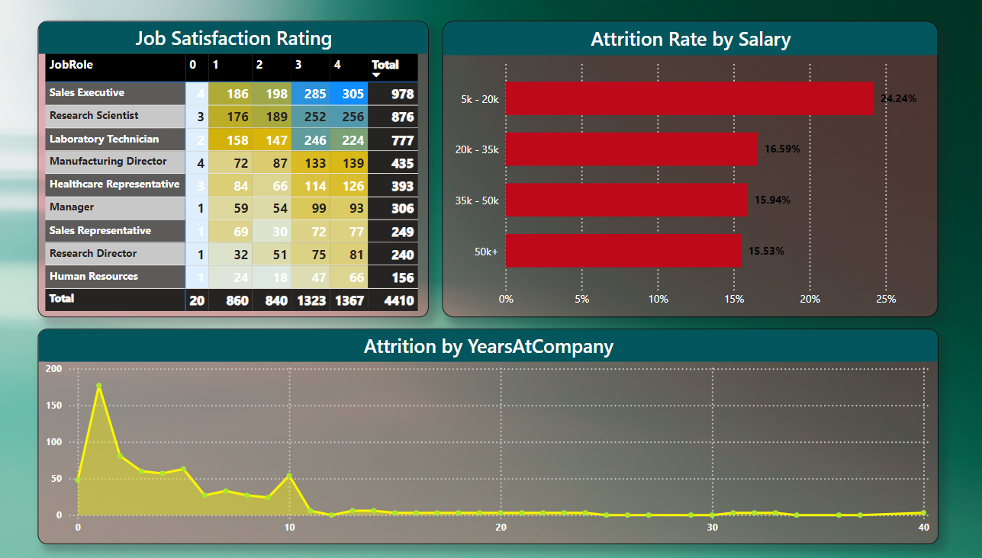

Slide 9
Thank You!

